Slide 1
FRACTAL NET
A Way Of Having Ultra Deep Networks Without Using Residuals
Soroush heidary - 96222031

Slide 2
Why Fractal Net
Ultra deep networks wouldn’t hurt !
Deepening without using residual techniques
Clear supervision over the training process
Simplicity of training
Less prone to overfitting
Less need for data augmentation
Alternatives to regularization and dropouts
Swift convergence in early training process

Slide 3
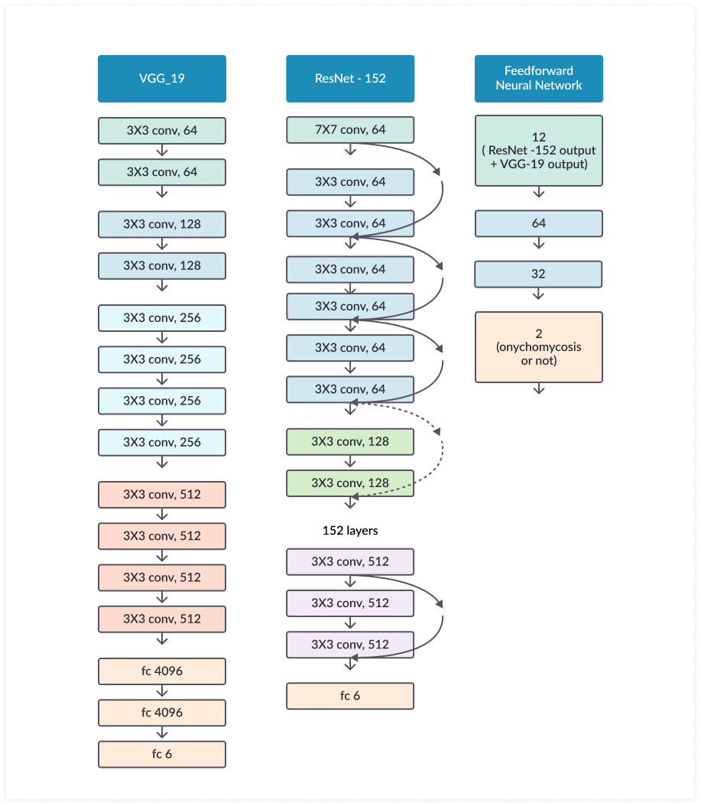
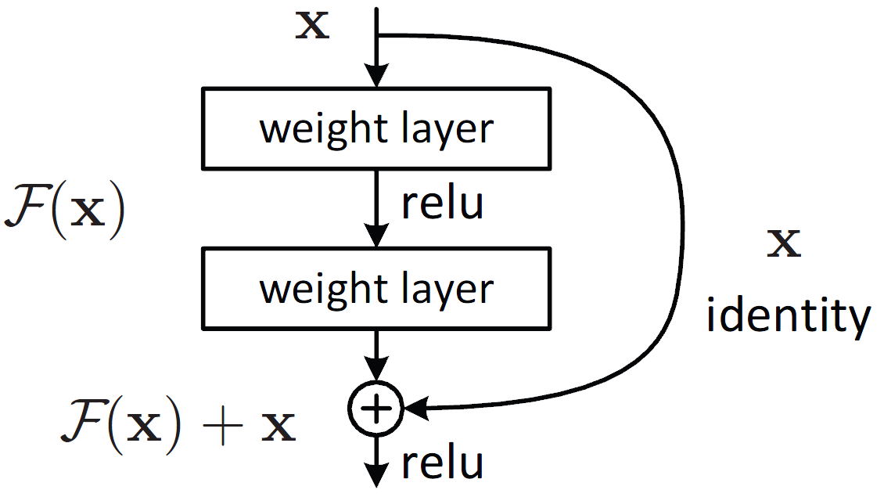
Depth, pros and cons (res-net vs fractal)

Slide 4
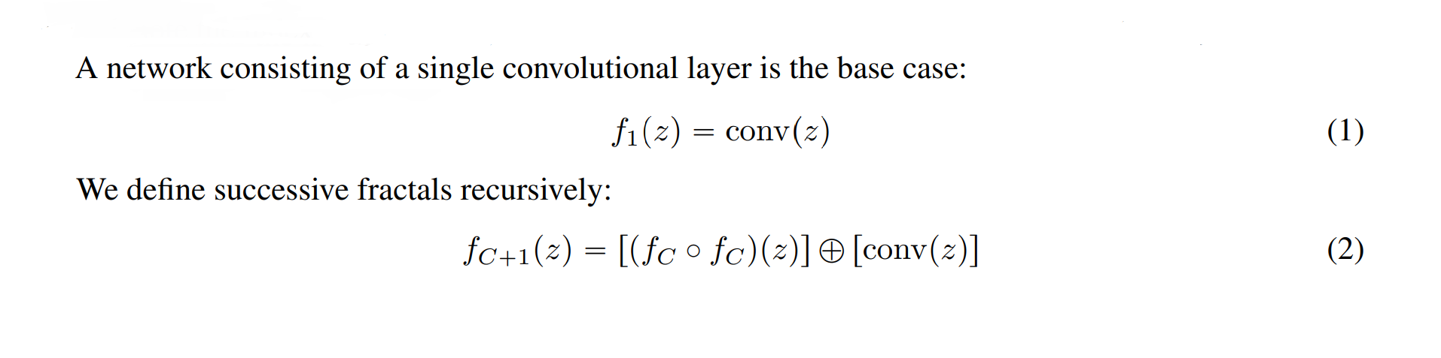
Main idea and structure of the network (as simple as the name suggests)

Slide 5
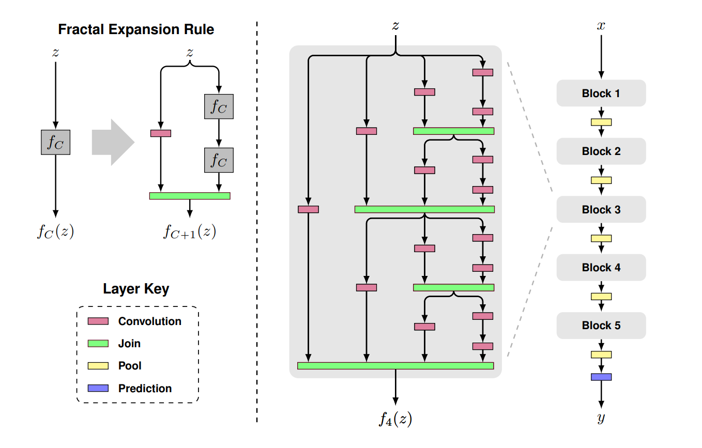

Slide 6
Architecture (fractal-specific params)
where C is the number of columns as in the middle of the figure. The number of convolutional layers at the deepest path within a block will have 2^(C-1). In this case, C=4, thereby, the number of convolutional layers is 2³=8 layers.
For the join layer (green), element-wise mean is computed. It is not concatenation or addition.
With 5 blocks (B=5) cascaded as FractalNet at the right of the figure, then the number of convolutional layers at the deepest path within the whole network is B×2^(C-1), i.e. 5×2³=40 layers.
In between 2 blocks, 2×2 max pooling is done to reduce the size of feature maps. Batch Norm and ReLU are used after each convolution.

Slide 7
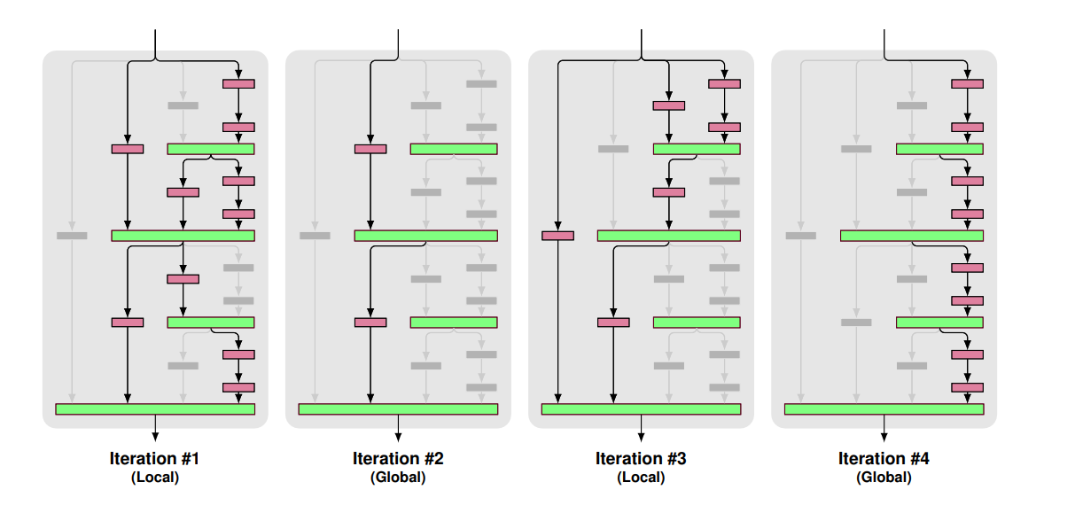
Dropout alternatives (drop-path)

Slide 8
Drop out as regularization
There are local and global drop-paths:
Local: A join drops each input with fixed probability, but it is sure that there is at least one survives.
Global: A single path is selected for the entire network.
By dropping path randomly, it is just like noise is injected to the input, and finally regularization effect is achieved to reduce overfitting.

Slide 9
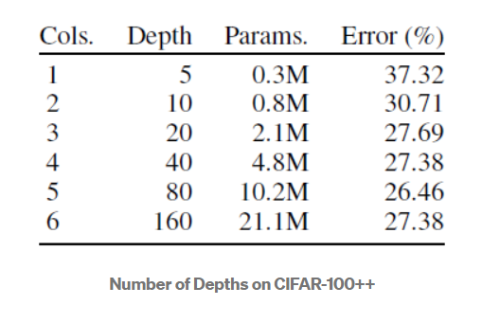
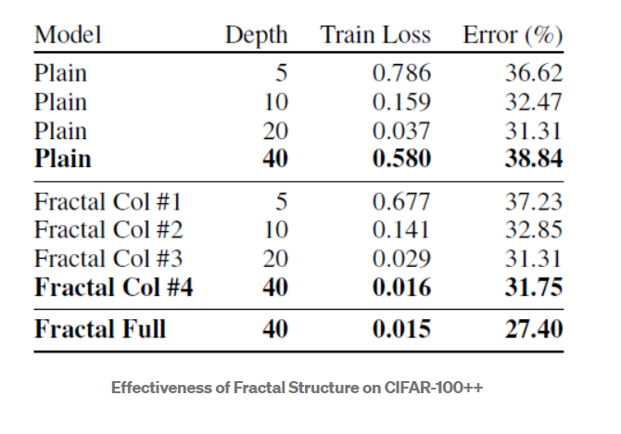
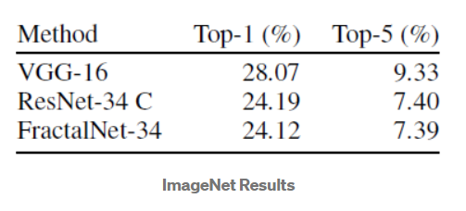
Layer depth and the consequences

Slide 10
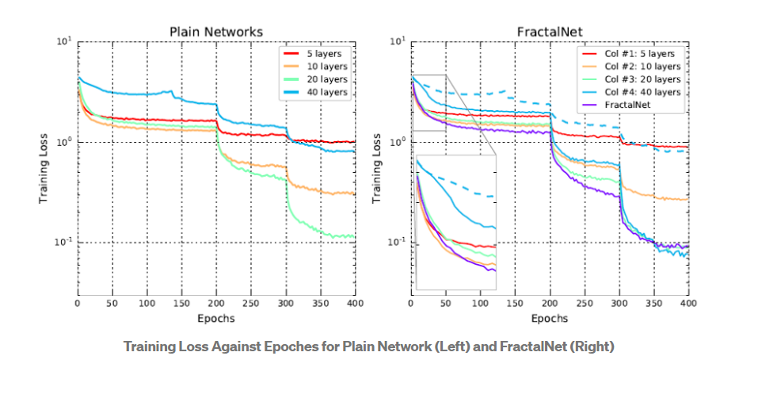
Comparison of Plain & fractal structures

Slide 11
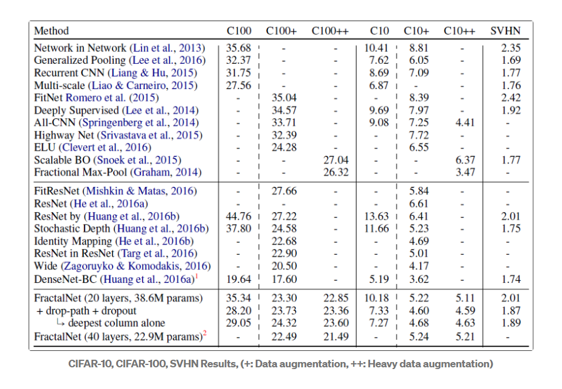
Results on cifar-10

Slide 12
C10 Analysis
Without any data augmentation, FractalNet obtain the lowest test error except the DenseNet-BC. And FractalNet outperforms ResNet by largin especially for C10 and C100.
With data augmentation, FractalNet can still outperforms almost all ResNet variants except the wide one (WRN) for C10+ and C100+.
But with heavy data augmentation (C10++ and C100++), FractalNet still cannot have the best result when comparing with those in C10+ or C100+.
And DenseNet-BC, which was the concurrent work at that moment, outperforms FractalNet for all tasks. But in this paper, the main purpose is to compare with ResNet, i.e. non-residual vs residual.

